Slide 1
Is Virtual Citizen Science A Game?
Presented by Neal Reeves
On behalf of Elena Simperl, Chris Phethean, Todd Lynes, Ramine Tinati

Slide 2
Introduction
Virtual Citizen Science – applying crowdsourcing to scientific research tasks – has been highly successful in a range of contexts
To be successful, projects must recruit and maintain the interest of thousands of volunteers over potentially many years
One method for this is the use of gamification – the use of game elements in non-game tasks and contexts (Deterding, 2011)
The impact of gamification on participation in VCS is significant area of research
However, impact on other aspects of success and of specific features less well understood

Slide 3
Virtual Citizen Science
Conducted entirely through a digital platform, with “no physical elements whatsoever” (Wiggins & Crowston, 2011)
Predominantly human computation processes involving analysis of existing assets and data
Generally designed so that anyone can participate, using simple and repeatable microtask workflows
Results are then aggregated and reviewed to ensure overall accuracy
Applied to a wide range of disciplines and task types

Slide 4
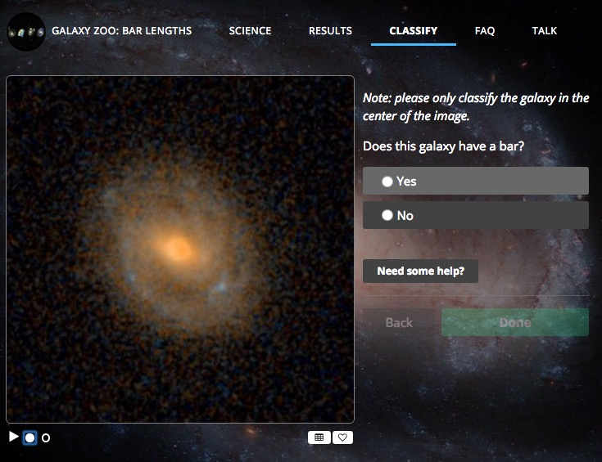

Slide 5
Methodology
Three distinct research methods:
Literature Review
4 databases – ACM Digital Library, SCOPUS, Web of Science, JSTOR
514 papers total
54 used within review
Project Review
Drawn from Wikipedia list of human computation games and citizen science projects.
31 projects found
Semi-structured interviews
6 full time employees from EyeWire
Executive director, developer, designer, three game masters

Slide 6
Literature Review

Slide 7
Motivation
Participants generally motivated by altruism and intrinsic motivation
Interest in science, specific field or specific research aim
Desire to contribute to science, research or common good
Game elements have little impact on these motivations.
But can still be engaging for participants (Greenhill et al, 2016)
Reward-based games negatively impact participants who show strong intrinsic motivations (Prestopnik and Tang, 2015)
Rewards-based gaming insufficient to overcome boredom associated with repetitive tasks

Slide 8
Data Quality
Data quality in gamified initiatives an area of concern and research…
…But specific conclusions from literature differ significantly
Negative impact
Thaler et al (2012) give example of 15% reduced data quality in games with a purpose
No impact
Prestopnik et al (2014) find no significant difference in performance between a highly game-based and gamified initiative
Positive impact
Study by Sabou et al. (2013) found players of a game to match or even surpass workers completing more traditional crowdsourcing activities

Slide 9
Project Review

Slide 10
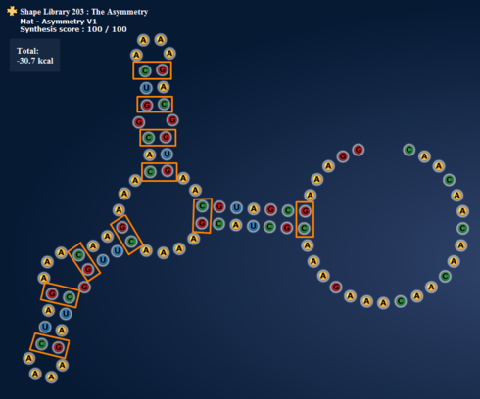
“Games”
More frequently driven by points and leaderboards
Progression and narrative uncommon
Rarely offered players special roles to perform (1 in 14)
Less likely to offer tutorials
Little to no focus on learning about science and tasks

Slide 11
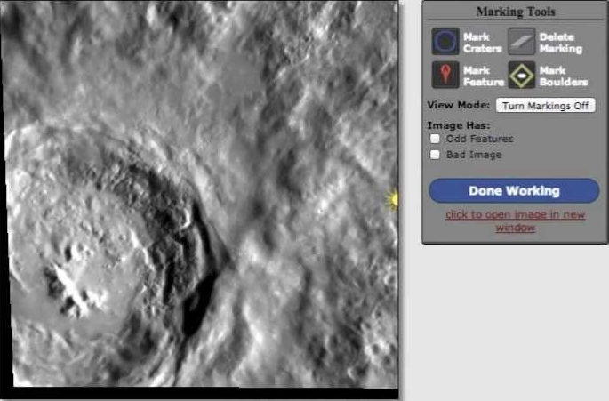
Non-games
Almost all emphasised altruistic nature of helping science
More likely to be collaborative and less likely to be competitive compared with games
More social features than games
Much higher focus on learning
Few explicit opportunities for progression and no narrative framing

Slide 12
Project Review
Ultimately three groups arise:
Games include game features and characteristics and use the descriptor ‘game’
Gamified projects do not use the descriptor game, but include game mechanics and/or some game features
Non-gamified projects rely on altruistic motivations and task framing, improving user engagement through features other than game elements
Not exactly consistency in terms of what is and isn’t a game…
…but gamified non-game projects tend to occupy middle ground
Altruism
Extrinisic motives
Intrinsic motives of game as fun activity
Intrinsic motives of interest in science

Slide 13
Interview Sessions

Slide 14
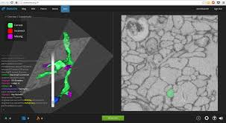
EyeWire
“A Game to Map the Brain”
Launched in 2012
Highly social
Integrated IM Chat
Forum
Blog
Wiki
Highly gamified
Points and leaderboard
Badges and rewards
Competitions and events

Slide 16
Scientific needs conflict with player expectations of games
…in several ways
“Anything that contributes towards your points score is definitely more incentivised than things that don’t.” (Participant 4)

Slide 17
‘Improvements’ may be demotivating for players
…even if they help with scientific tasks
“[New cube meshes] were more scientifically accurate, but ironically the community had grown accustomed to the… old meshes”

Slide 18
Science progresses slowly…
…Which harms players intrinsic motivations
“One of the players was like ‘so what have you learned since last time?’... ‘Oh, we haven’t even looked at them.’ That was the truth but it made the players feel like crap.” (Participant 1)

Slide 19
Fun games aren’t necessarily good science
…In terms of efficiency and cost-effectiveness
“There was definitely a push to make EyeWire more efficient than it was… More money was being put in [to run the game] than the money being put into paying tracers at Princeton…”

Slide 20
Scientific needs restrict the features that can be added
…But players don’t necessarily care
“Our problem is… [in terms of offers of new game ideas] we have… a lot of restrictions on how we need to do things to get accurate scientific results.”

Slide 21
Conclusion
Views and findings on the use of gamification in VCS vary…
…As do specific features and the use of the term game
Gamification generally applied to increase participation…
…But has serious implications for additional factors such as:
Data Quality
Perceptions of VCS as scientific activity
Volunteer behaviours
Volunteer motivations

Slide 22
Thank you/Any Questions?
Thank you to:
The EyeWire team for their time and input
The anonymous reviewers for their comments
The journal editors
My co-authors
You for listening
Email: neal.reeves@soton.ac.uk

